Slide 1
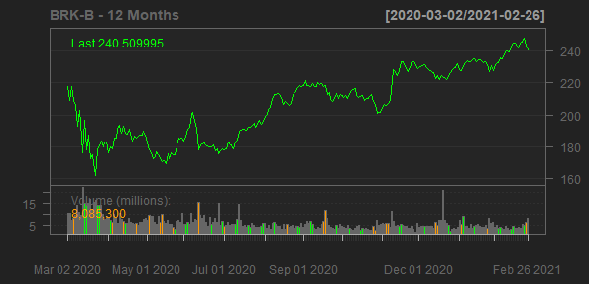
Berkshire Hathaway Inc.
BRK-B
Sector: Financial Services
Industry: Insurance—Diversified
Berkshire Hathaway Inc., through its subsidiaries, engages in insurance, freight rail transportation, and utility businesses. It provides property, casualty, life, accident, and health insurance and reinsurance; and operates railroad systems in North America. The company also generates, transmits, stores, and distributes electricity from natural gas, coal, wind, solar, hydro, nuclear, and geothermal sources; operates natural gas distribution and storage facilities, interstate pipelines, and compressor and meter stations; and holds interest in coal mining assets. In addition, it offers real estate brokerage services; and leases transportation equipment and furniture. Further, the company manufactures boxed chocolates and other confectionery products; specialty chemicals, metal cutting tools, and components for aerospace and power generation applications; flooring, insulation, roofing and engineered, building and engineered components, paints and coatings, and bricks and masonry products, as well as offers homebuilding and manufactured housing finance; and recreational vehicles, apparel products, jewelry, and custom picture framing products, and alkaline batteries. Additionally, it manufactures castings, forgings, fasteners/fastener systems, and aerostructures; and seamless pipes, fittings, downhole casing and tubing, and various mill forms. The company distributes newspapers, televisions, and information; franchises and services quick service restaurants; distributes electronic components; and offers logistics services, grocery and foodservice distribution services, and professional aviation training and fractional aircraft ownership programs. It also retails automobiles; furniture, bedding, and accessories; household appliances, electronics, and computers; jewelry, watches, crystal, china, stemware, flatware, gifts, and collectibles; kitchenware; and motorcycle accessories. The company was incorporated in 1998 and is headquartered in Omaha, Nebraska.
Sales Growth
EBIT Margin
12%
11.48%
41.19%
40%
9%
30%
6%
EBIT Margin
Sales Growth
20%
16.82%
2.86%
3.46%
10.48%
3%
10%
4.05%
0%
0%
2017-12-31
2018-12-31
2019-12-31
2016-12-31
2017-12-31
2018-12-31
2019-12-31
Date
Date

